Slide 1
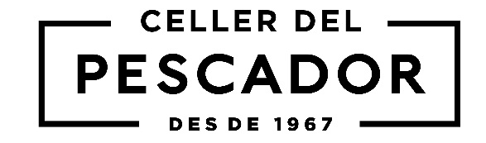
A Mediterranean dream: a lightly sparkling wine that proclaim its love of the sea.
Ageing
Young Wine.
Type of bottle
Rhine, tall, white, 75 cl. and 37.5 cl.
Varietals
Macabeo (61%), Xarel·lo (33%), Parellada (6%)
Tasting Note
Pale and bright green yellow tinge.
Aromatic, slightly fruity and delicately lively. It has a refreshing, light and clean palate.
Analysis
ABV:11,5% by Vol. Pressure at 20ºC: 2,5 bar.
Total SO2: Less 150 mg/l.
Total acidity: 3,5-4 g/l (s.a.).
Volatile acidity: Less than 0,6 g/l
Residual sugar:5-6 g/l.
Winemaking
The second fermentation using the Charmat method.
Blanc Pescador
Lightly sparkling Wine
@blancpescador
@blancpescador
@blancpescador
www.blancpescador.com

